Slide 1
HAART data analysis
Lingdi Zhang
09-24-2018

Slide 2
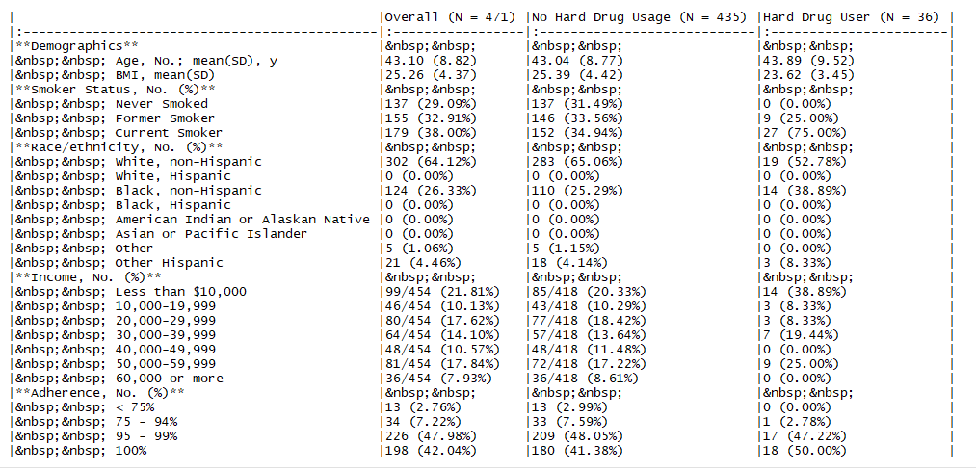
Table 1
Variables sorted by number of missings:
Variable Count
VLOAD.2 0.028688525
LEU3N.2 0.028688525
lVLOAD 0.028688525
AGG_PHYS.2 0.012295082
AGG_MENT.2 0.012295082
VLOAD.0 0.008196721
hard_drugs.2 0.008196721
LEU3N.0 0.006147541
AGG_PHYS.0 0.002049180
AGG_MENT.0 0.002049180
X 0.000000000
income.0 0.000000000
BMI.0 0.000000000
age.0 0.000000000
RACE.0 0.000000000
ADH.2 0.000000000
SMOKE.0 0.000000000
hard_drugs.0 0.000000000
Question of Interest:
We are interested in understanding how treatment response 2 years after initiating HAART differs between subjects who report using hard drugs, such as heroin and cocaine, at baseline and other subjects, who did not report hard drug use at baseline.
Outcomes: LVLOAD, LEU3N, AGG_PHYS, AGG_MENT
Variables: hard_drug, adjusted by income, BMI, age, race, ADH, and smoke

Slide 3
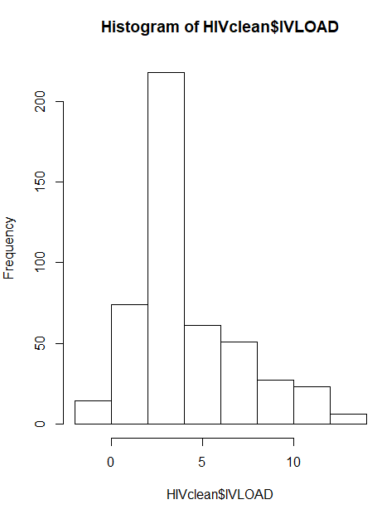
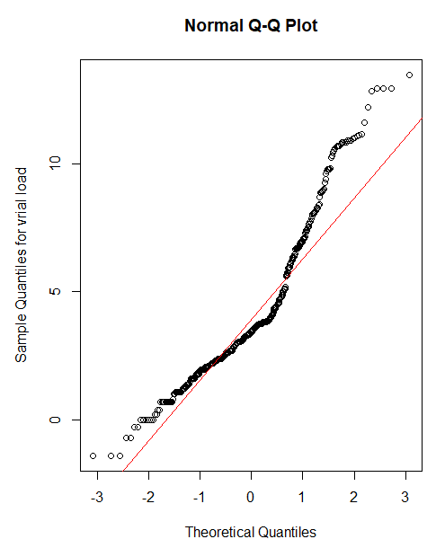
Log transformation of outcome VLOAD into lVLOAD
After transformation
Before transformation

Slide 4
Correlation plot

